Slide 1
MODULE III – DC MACHINES
Construction, principle of operation, basic equations, characteristics and applications of DC generators, DC motors, single phase transformers and three phase induction motors. Working principle of BLDC Motor and its applications in home appliances.

Slide 2
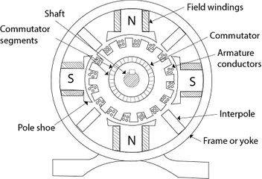
CONSTRUCTION OF DC GENERATOR

Slide 3
The main parts of DC machines are;
1) Yoke or Frame or Magnetic frame 2) Poles and Pole shoe 3) Armature 4) Armature winding and Field winding 5) Commutator 6) Brushes 7) Shaft

Slide 4
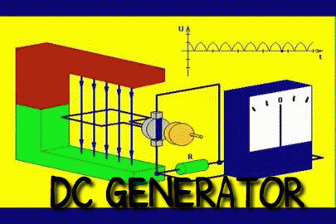
What is a DC Generator?
A DC generator is an electrical machine whose main function is to convert mechanical energy into electricity.
When the conductor slashes magnetic flux, an emf will be generated based on the electromagnetic induction principle of Faraday’s Laws.
This electromotive force can cause a flow of current when the conductor circuit is closed.

Slide 5
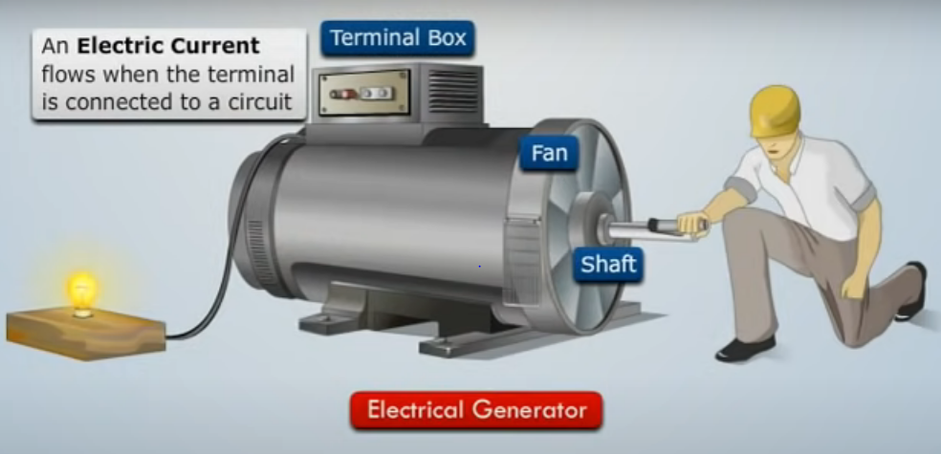
ELECTRICAL GENERATOR – CONVERTS MECHANICAL ENERGY TO ELECTRICAL ENERGY.

Slide 6
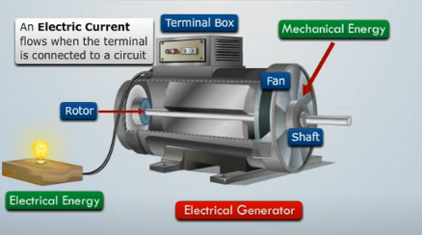

Slide 7
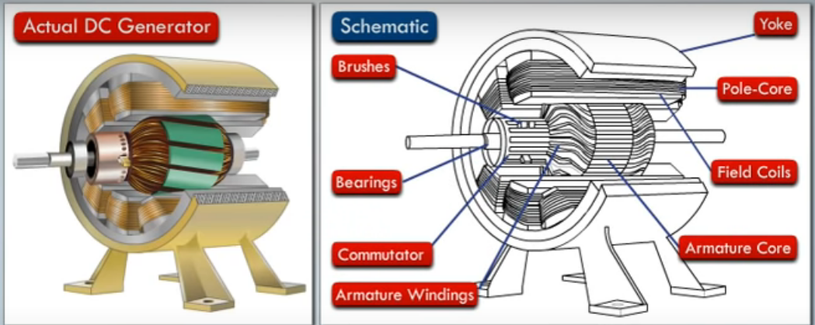
Construction of a DC Generator

Slide 8
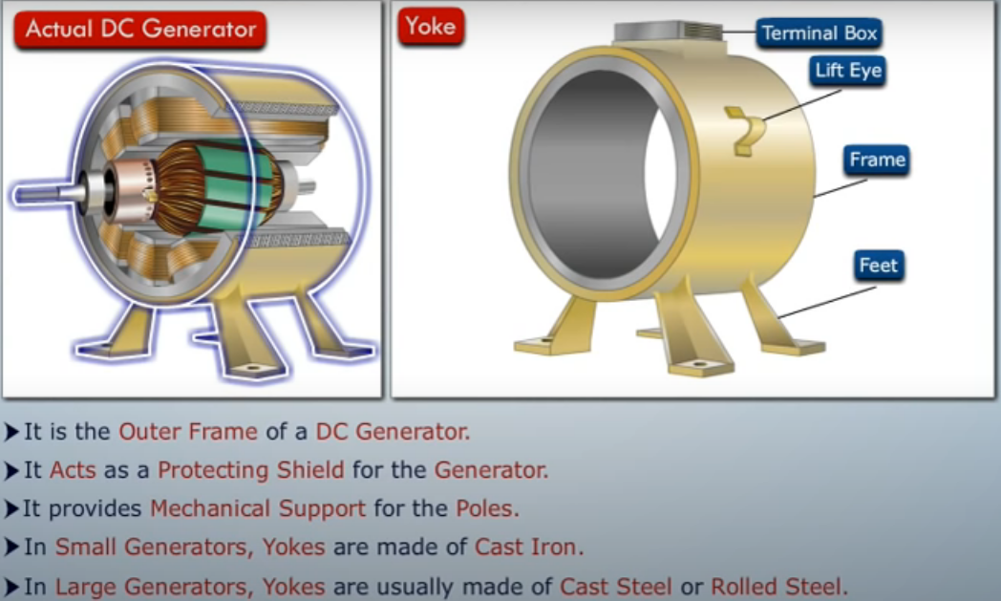

Slide 9
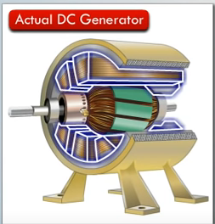
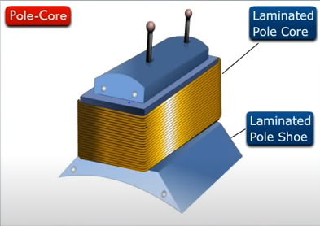
Poles
The function of a pole is to hold the field windings. These windings are wound on poles and are either connected in series or parallel by the armature windings.
Pole Shoe
Pole shoe is mainly utilized for spreading the magnetic flux to prevent the field coil from falling.

Slide 10
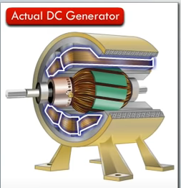
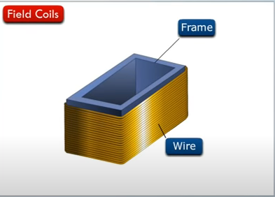
Stator
The main function of the stator is to provide magnetic fields where the coil spins.
A stator includes two magnets with opposite polarities facing each other.
These magnets are located to fit in the region of the rotor.

Slide 11
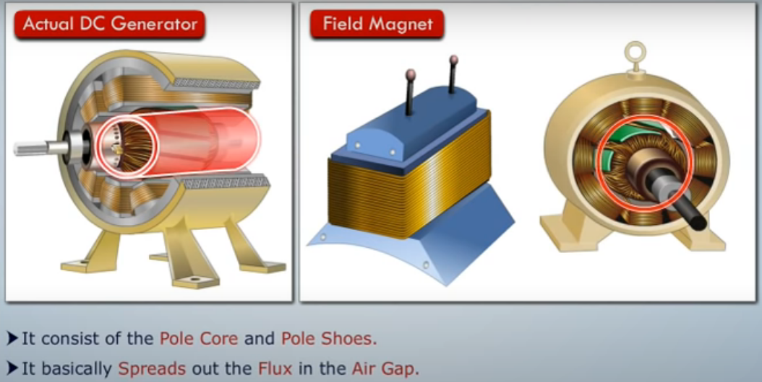

Slide 12
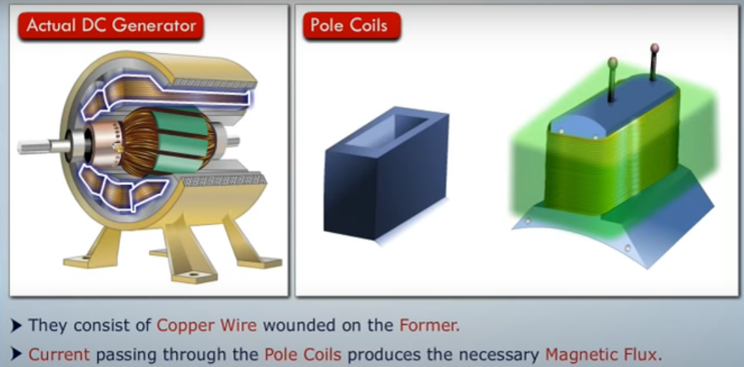

Slide 13
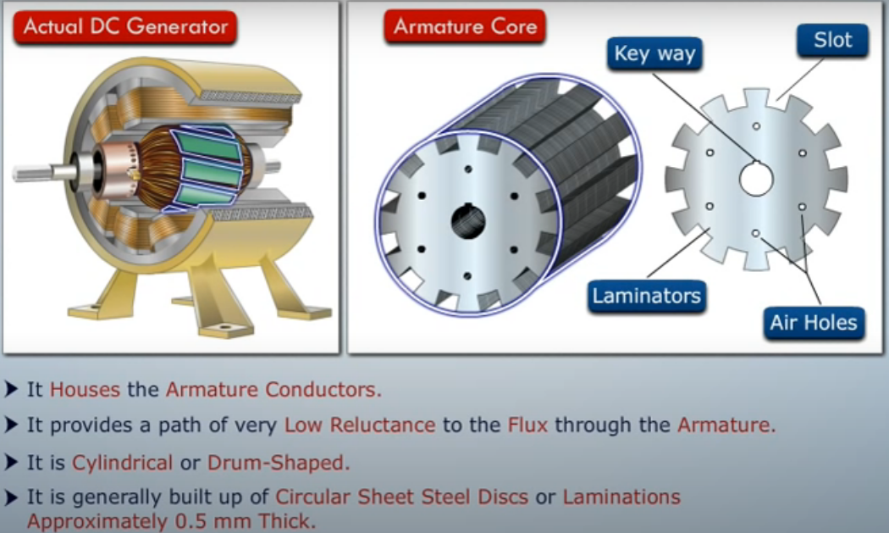

Slide 14
Rotor
A rotor in a DC machine includes slotted iron laminations with slots that are stacked to shape a cylindrical armature core.
The function of the lamination is to decrease the loss caused due to eddy current.

Slide 15
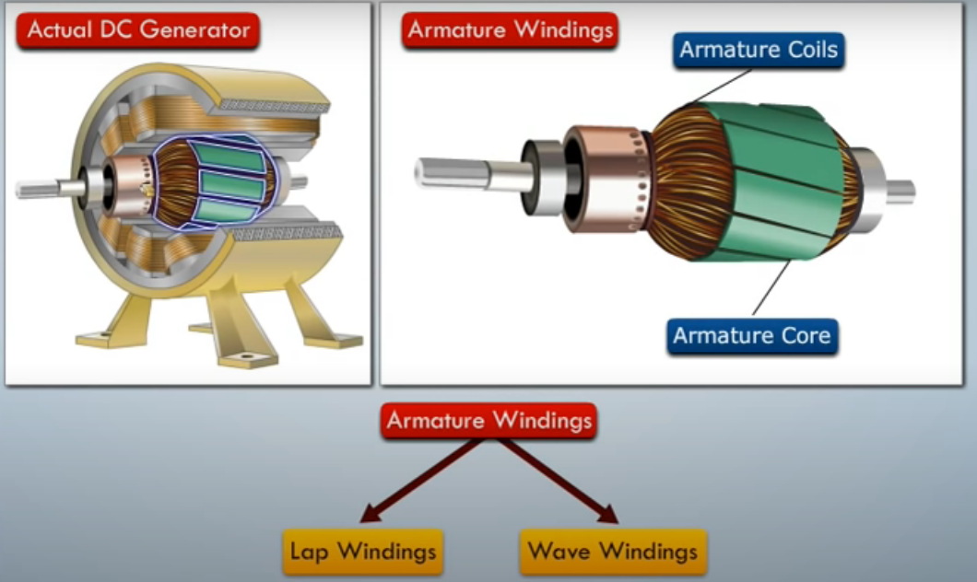

Slide 16
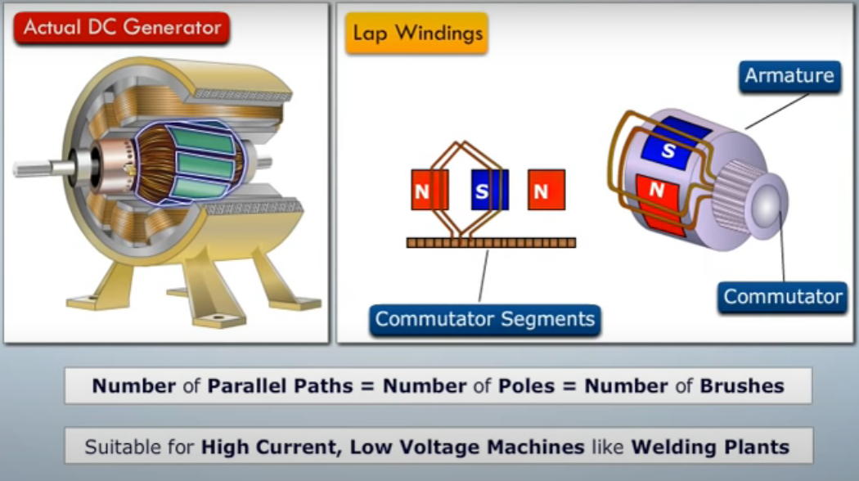

Slide 17
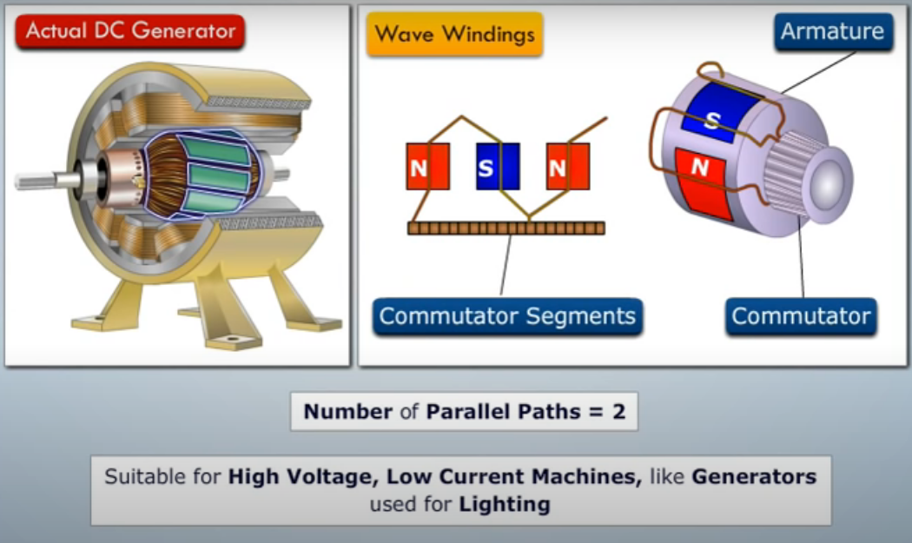

Slide 18
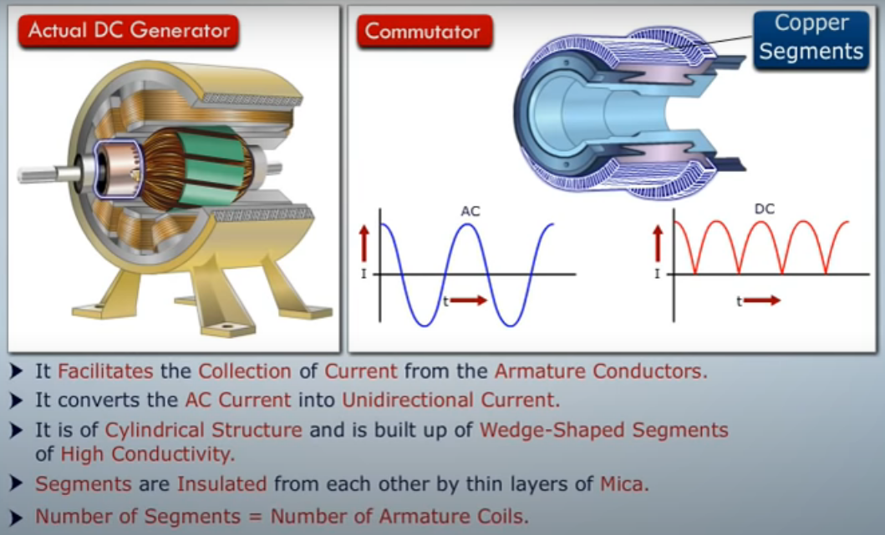

Slide 19
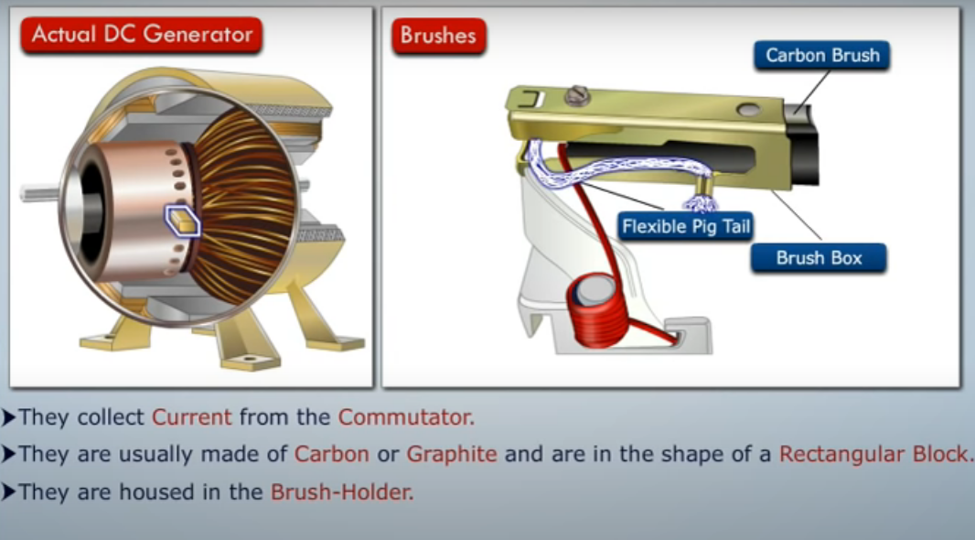

Slide 20
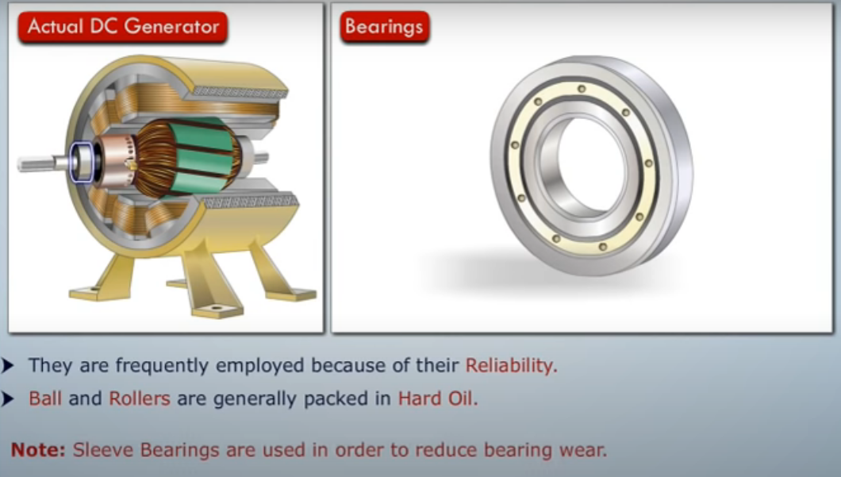

Slide 21
DC Generator
A DC generator is an electromechanical energy conversion device that converts mechanical power into DC electrical power through the process of electromagnetic induction.
Working Principle:
A DC generator operates on the principle of electromagnetic induction i.e. when the magnetic flux linking a conductor changes, an EMF is induced in the conductor. A DC generator has a field winding and an armature winding.
The EMF induced in the armature winding of a DC generator is alternating one and is converted into direct voltage using a commutator mounted on the shaft of the generator.
The armature winding of DC Generator is placed on the rotor .
The field winding is placed on the stator.

Slide 22
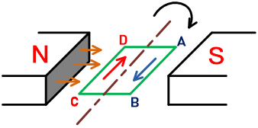
Hence the most basic two essential parts of a generator are:
The magnetic field
Conductors which move inside that magnetic field.
To understand the working of the DC generator, take a single loop generator. The figure of this generator is as shown in the below figure.

Slide 23
A loop made from two conductors.
Conductor-1 is AB and conductor-2 is CD. A single loop ABCD is made from these conductors.
As shown in the above figure, a rectangular loop of a conductor (ABCD) rotates between two magnets.
The magnets can be permanent magnets or electromagnets and create a magnetic field.
The direction of the magnetic field is always from N-pole to S-pole.
When the loop rotates, it cuts the magnetic flux lines. And it induces EMF in a loop.
This loop is a closed path.
So, the current will flow through the loop.
Fleming’s Right-Hand Rule determines the direction of the current.

Slide 24
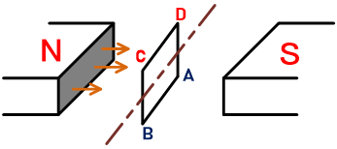
Now for the above arrangement, if we find the current direction, it will be from A to B in conductor-1 and C to D in conductor-2.
Now, the loop rotates inside the magnetic field and comes vertical position. The conductor CD is on top, and AB is on the opposite side of the CD.
This arrangement is shown in the below figure.
Here in this condition, there is no chance to cut flux lines because the loop is perpendicular to the flux lines.
Therefore, EMF is not induced in this condition.

Slide 25
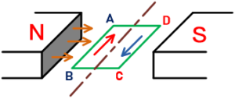
Now, the loop further rotates and again comes in a horizontal position. The left conductor is AB, and the suitable conductor is CD.
This arrangement is as shown in the below figure.
This condition is the opposite to the first condition.
Here, the loop is parallel to the flux lines.
And so, the flux cutting is maximum. So maximum EMF will produce in this condition.

Slide 26
If you apply Fleming’s Right-Hand Rule and find the current direction, it will be from B to A in conductor-1 and D to C in conductor-2.
This current direction is in the opposite direction of the current direction in the first case.

Slide 27
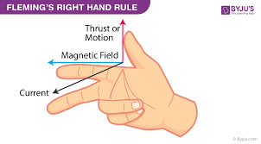
In Fleming’s Right-hand Rule, the thumb, index finger, and middle finger of the right hand make perpendicular to each other.
The thumb indicates the direction of rotation of the loop,
the index finger indicates the direction of the magnetic field, and
the middle finger indicates the direction of the flow of current through the loop.

Slide 28
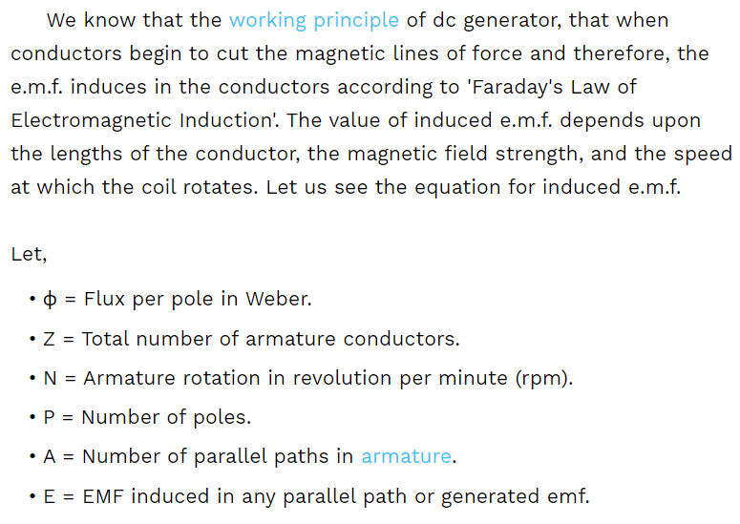
EMF EQUATION

Slide 29
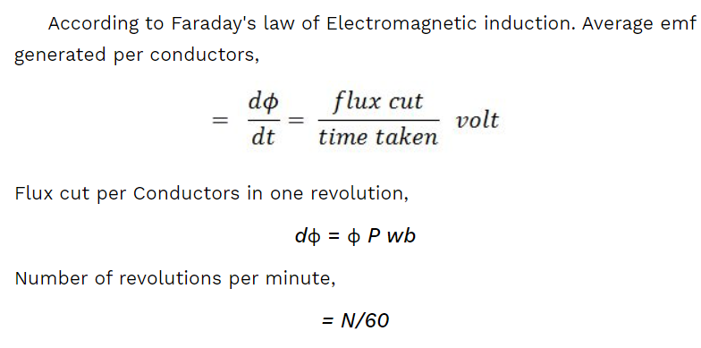

Slide 30
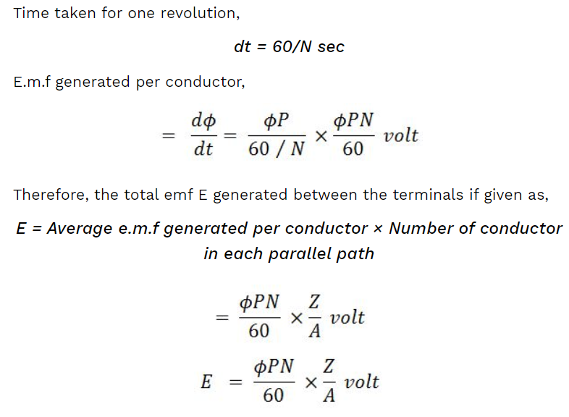
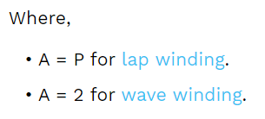

Slide 31
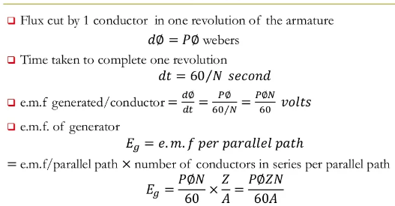
EMF equation of generator

Slide 32
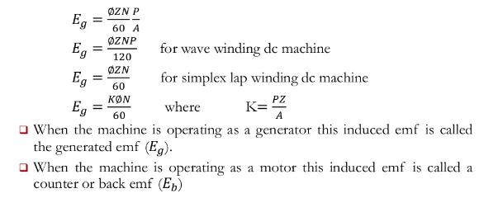

Slide 33
Types of DC Generator
DC generators are generally classified according to their method of excitation .
Separately excited DC generator
Self excited D C generator

Slide 34

Further classification of DC Generator
Series wound generator
Shunt wound generator
Compound wound generator
Short shunt & Long shunt
Cumulatively compound
&
Differentially compound

Slide 35
Characteristics
No load saturation characteristic (Eo/If)
Internal or Total characteristic (E/ Ia)
External characteristic (V/I)

Slide 36
1. Open Circuit Characteristic (O.C.C.) (E₀/I_{f})
Open circuit characteristic is also known as magnetic characteristic or no-load saturation characteristic. This characteristic shows the relation between generated emf at no load (E₀) and the field current (I_{f}) at a given fixed speed. The O.C.C. curve is just the magnetization curve and it is practically similar for all type of generators. The data for O.C.C. curve is obtained by operating the generator at no load and keeping a constant speed. Field current is gradually increased and the corresponding terminal voltage is recorded. The connection arrangement to obtain O.C.C. curve is as shown in the figure below. For shunt or series excited generators, the field winding is disconnected from the machine and connected across an external supply.

Slide 37
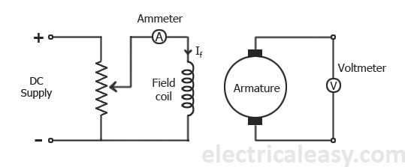

Slide 38
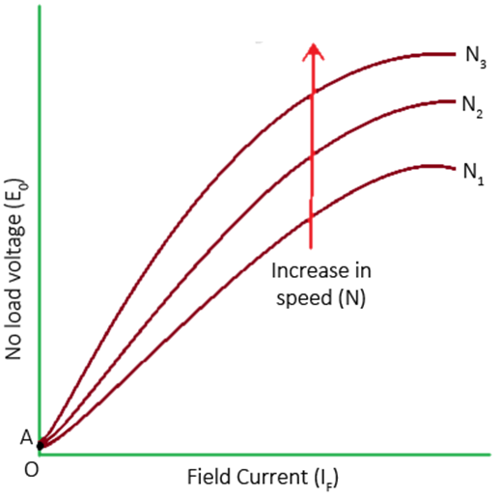

Slide 39
2. Internal Or Total Characteristic (E/I_{a})
An internal characteristic curve shows the relation between the on-load generated emf (Eg) and the armature current (I_{a}). The on-load generated emf Eg is always less than E₀ due to the armature reaction. Eg can be determined by subtracting the drop due to demagnetizing effect of armature reaction from no-load voltage E₀. Therefore, internal characteristic curve lies below the O.C.C. curve.

Slide 40
3. External Characteristic (V/I_{L})
An external characteristic curve shows the relation between terminal voltage (V) and the load current (I_{L}). Terminal voltage V is less than the generated emf Eg due to voltage drop in the armature circuit. Therefore, external characteristic curve lies below the internal characteristic curve. External characteristics are very important to determine the suitability of a generator for a given purpose. Therefore, this type of characteristic is sometimes also called as performance characteristic or load characteristic.

Slide 41
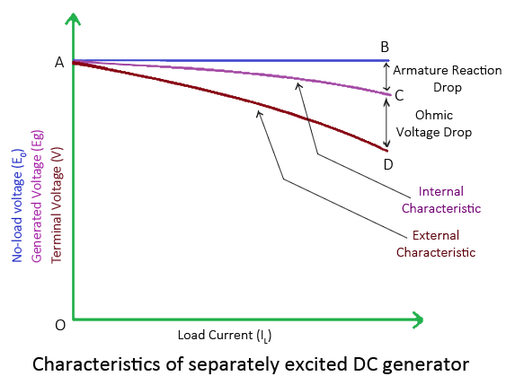

Slide 42
Applications
Shunt Generators:
a. in electro plating
b. for battery recharging
c. as exciters for AC generators.
Series Generators :
A. As boosters
B. As lighting arc lamps

Slide 43
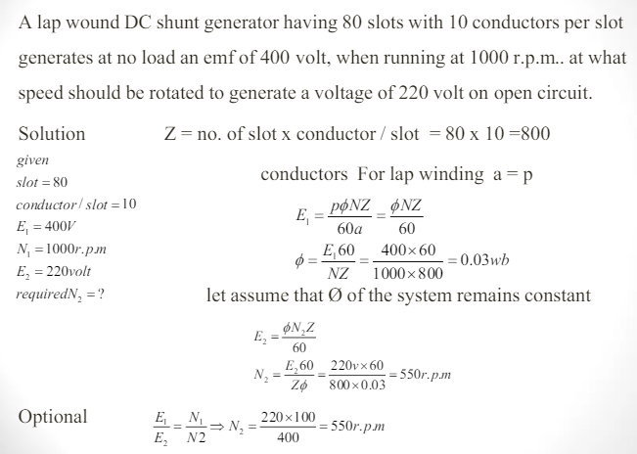

Slide 44
DC MOTOR
Generally, A.C motors are preferred widely in industries.
But when it comes to high starting torque or efficient speed control DC motors are the optimal choice.
They are used in aluminum rolling mills, electric elevators, railroad locomotives, and large earth-moving equipment.

Slide 45
A DC motor is an electromechanical energy conversion device, which converts electrical energy input into the mechanical energy output.
WORKING PRINCIPLE
The operation of the DC motor is based on the principle that when a current carrying conductor is placed in a magnetic field, a mechanical force acts on the conductor. The magnitude of the force is given by,
F=B*I*l Newtons
The direction of the force is given by the Fleming’s left hand rule.

Slide 46
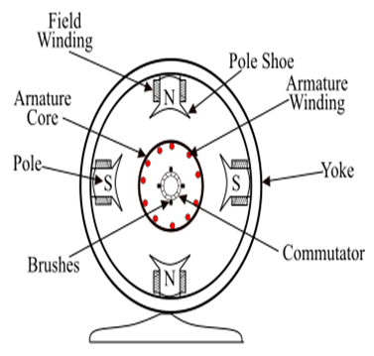
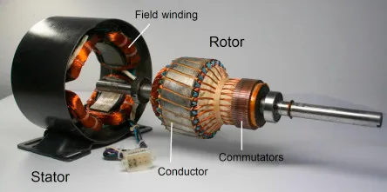
Construction of a DC Motor

Slide 47
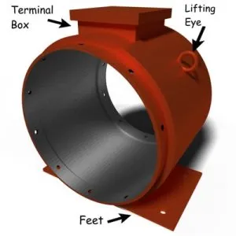
PARTS OF THE STATOR:-
YOKE:
The yoke or outer frame provides coverage to a dc motor. It is made up of cast steel for large dc motors. And of cast iron for small dc motors. The yoke is used in DC machines because:
A) It provides mechanical support to poles.
B) Acts as a protective cover against mechanical damage.
C) And provides a passage for the magnetic flux produced by the poles of the machine.

Slide 48
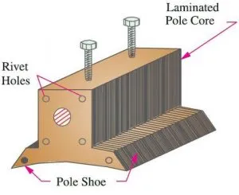
POLE CORE AND POLE SHOE:
Both pole core and pole shoes are made of cast steel.
But pole shoes are laminated as they are close to the armature.
If the load changes during the operation of the DC motor, the armature current changes. As a result the magnetic flux also changes.
This flux links the pole shoe and causes eddy current to flow.
And to minimize these eddy currents, pole shoes are laminated.
The main purpose of the pole shoe is to spread the flux and reduce the reluctance of the magnetic path.
Whereas the pole core is excited with field winding and used to support them.

Slide 49
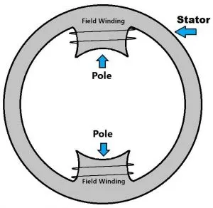
POLE WINDING OR FIELD COILS
The pole winding and field coils consist of copper wire placed in position around the pole core.
When current passes through these coils, they electro-magnetize the pole which produces the magnetic flux.
This flux passes through the rotor and produces a rotating torque as soon as the current starts flowing in the armature of the rotor.

Slide 50
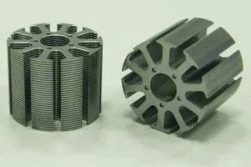
PARTS OF THE ROTOR:-
ARMATURE CORE
The armature core is the rotating part of a DC/AC machine.
It is made up of silicon steel.
The cylindrical structure is laminated to reduce the eddy current loss.
Its main purpose is to offer a low reluctance path to the magnetic flux.
And to house the armature conductors.

Slide 51
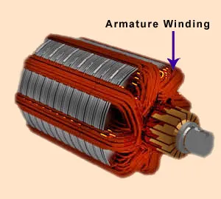
ARMATURE WINDING
Armature winding is composed of coils embedded in armature core slots.
These coils are lined next to each other with tough insulating material.
The insulating material prevents the two adjacent coils from a short circuit.
Whereas the slot insulation is folded over the armature conductor and is secured firmly by wood or Fibre wedges.
In simple words, it is an arrangement of current-carrying conductors that produce EMF in the machine due to relative motion between the windings and the main field.

Slide 52
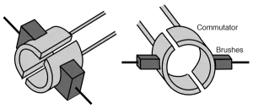
COMMUTATOR
The commutator contains wedge-shaped hard-drawn copper segments, forming a cylindrical structure.
A thin sheet of high-quality mica insulates the segments from each other.
A commutator periodically changes the direction of the current between the rotor and the external circuit.
Hence, it acts as a switch causing a unidirectional torque in the dc motor.

Slide 53
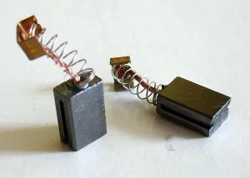
BRUSHES
Brushes are usually made of rectangular carbon blocks housed in brush holders.
The function of brushes in DC motors is to supply the current to the commutator from an external dc source.
Whereas the function of the brushes in a DC generator is to collect the current from the commutator and supply it to the external load circuit.

Slide 54
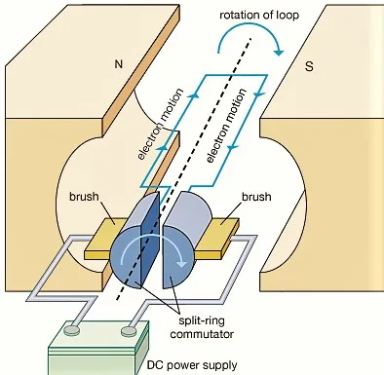
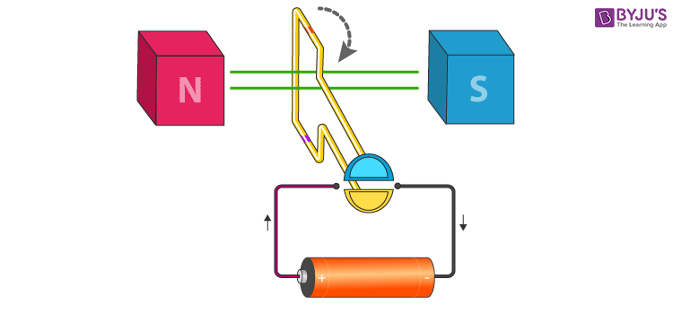
WORKING OF DC MOTOR
The working principle of a DC motor requires magnetic flux and a current-carrying conductor.
Consider a coil carrying DC current through commutator and brushes. These commutator segments rotate freely about its axis.

Slide 55
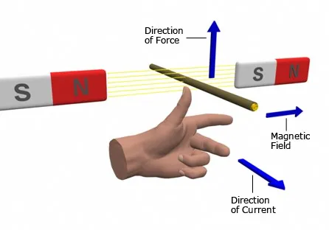
FLEMING’S LEFT-HAND RULE
If you stretch the index finger, middle finger, and thumb of the left hand mutually perpendicular to each other.
If the index finger indicates the direction of the magnetic field, the middle finger indicates the direction of current through the conductor, then the thumb will indicate the direction of force acting on the conductor.

Slide 56
The commutator segment which comes in contact with the left brush gets positive polarity while the right one gets negative polarity. This leads to the flow of current in the coil.
By applying Fleming’s Left-Hand Rule, the conductor on the left side always experiences a force in an upward direction while the conductor on the right side experiences a downward force.
Hence, a unidirectional torque is achieved in dc motors.
BACK EMF
The interaction of the current-carrying conductor with the changing magnetic field produced by the field winding induces an EMF in the conductor. This EMF acts in the opposite direction to the applied voltage. This induced EMF in the motor is known as BACK EMF.

Slide 57
Torque Equation Of A DC Motor
When armature conductors of a DC motor carry current in the presence of stator field flux, a mechanical torque is developed between the armature and the stator. Torque is given by the product of the force and the radius at which this force acts.
MECHANICAL OUTPUT POWER Torque T = F × r (N-m) …where, F = force and r = radius of the armature
Work done by this force in one revolution = Force × distance = F × 2πr (where, 2πr = circumference of the armature)
Net power developed in the armature = work done / time = (force × circumference × no. of revolutions) / time = (F × 2πr × N) / 60 (Joules per second) .... eq. 2.1
But, F × r = T and 2πN/60 = angular velocity ω in radians per second. Putting these in the above equation 2.1 Net power developed in the armature = P = T × ω (Joules per second)

Slide 58
The power developed in the armature can be given as, Pa = Ta × ω = Ta × 2πN/60
The mechanical power developed in the armature is converted from the electrical power, Therefore, mechanical power = electrical power That means, Ta × 2πN/60 = Eb.Ia
We know, Eb = PΦNZ / 60A
Therefore, Ta × 2πN/60 = (PΦNZ / 60A) × Ia
Rearranging the above equation, Ta = (PZ / 2πA) × Φ.Ia (N-m)
The term (PZ / 2πA) is practically constant for a DC machine. Thus, armature torque is directly proportional to the product of the flux and the armature current i.e. Ta ∝ Φ.Ia
Shaft torque of a DC motor is given as, Tsh = O/P POWER in watts / (2πN/60) ....(where, N is speed in RPM)

Slide 59
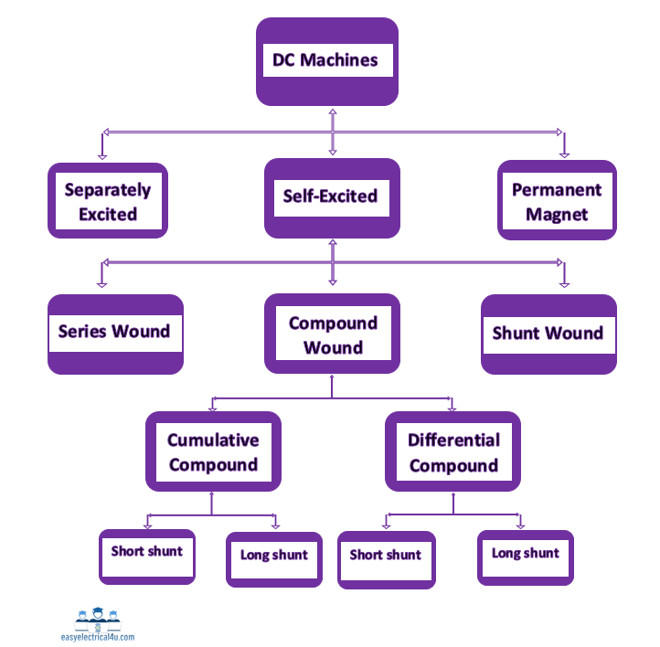
TYPES OF DC MOTOR

Slide 60
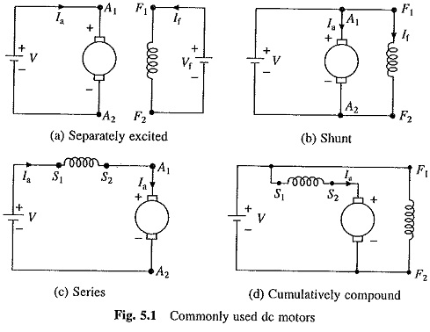

Slide 61
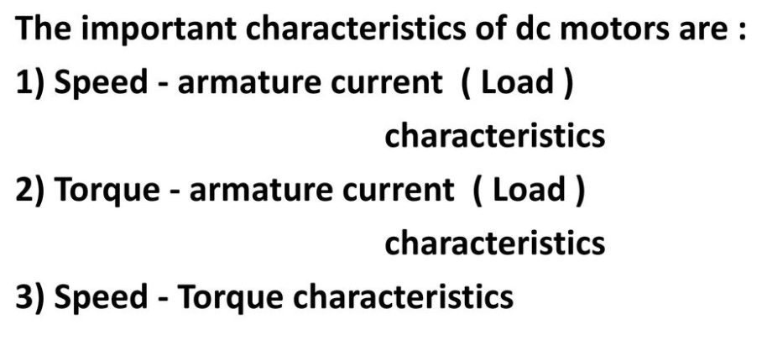
CHARACTERISTICS OF DC MOTOR
ELECTRICAL CHARACTERISTICS
MECHANICAL CHARACTERISTICS

Slide 62
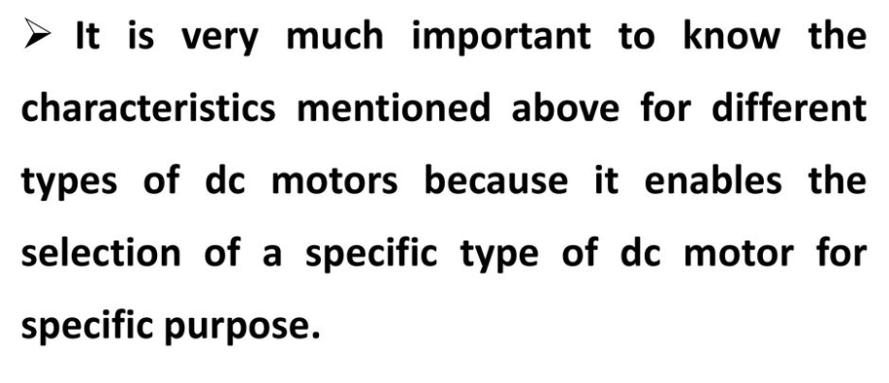

Slide 63
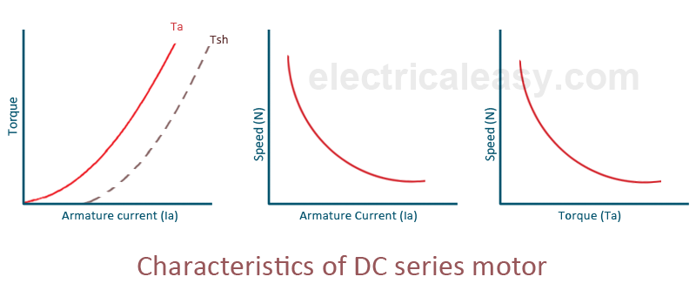

Slide 64


Slide 65


Slide 66
Applications of DC Motors
The main applications of the three types of direct current motors are given below.
Series Motors
The series DC motors are used where high starting torque is required and variations in speed are possible.
For example – the series motors are used in the traction system, cranes, air compressors, Vaccum Cleaner, Sewing machine, etc.
Shunt Motors
The shunt motors are used where constant speed is required and starting conditions are not severe. The various applications of DC shunt motor are in Lathe Machines, Centrifugal Pumps, Fans, Blowers, Conveyors, Lifts, Weaving Machine, Spinning machines, etc.
Compound Motors
The compound motors are used where higher starting torque and fairly constant speed is required. The examples of usage of compound motors are in Presses, Shears, Conveyors, Elevators, Rolling Mills, Heavy Planners, etc.
The small DC machines whose ratings are in fractional kilowatt are mainly used as control device such in techno generators for speed sensing and in servo motors for positioning and tracking.

Slide 67

TRANSFORMER
Electrical transformer is a static electrical machine which transforms electrical power from one circuit to another circuit, without changing the frequency.
Transformer can increase or decrease the voltage with corresponding decrease or increase in current.

Slide 68

Types Of Transformers
On the basis of construction

Slide 69

On the basis of their purpose

Slide 70

On the basis of type of supply
1. Single-phase transformer
2. Three-phase transformer

Slide 71
On the basis of their use Power transformer: Used in transmission network, high rating
Distribution transformer: Used in distribution network, comparatively lower rating than that of power transformers.
Instrument transformer: Used in relay and protection purpose in different instruments in industries
Current transformer (CT)
Potential transformer (PT)

Slide 72
On the basis of cooling employed Oil-filled self cooled type
Oil-filled water cooled type
Air blast type (air cooled)

Slide 73


CONSTRUCTION OF SINGLE PHASE TRANSFORMER

Slide 74
Transformer is a static device by which alternating electric power is transformed from one circuit to another circuit linked by a common magnetic flux without any change of frequency.
It can raise or lower the voltage simply. A transformer consists two or more inductive coils which have high mutual inductance.
It has two parts i) core
ii) coils.
If one coil of the transformer is connected to a source of alternating voltage, an alternating flux is set up in the laminated core, most of the flux is linked with the other coil, according to Faraday’s Laws of electromagnetic induction (e=MdI/dt) it produces mutually-induced e.m.f.
The first coil in which the a.c supply is applied, is called primary winding and others coil in which e.m.f produce, is called secondary winding.

Slide 75
The basic principle behind working of a transformer is the phenomenon of mutual induction between two windings linked by common magnetic flux.
Basically a transformer consists of two inductive coils; primary winding and secondary winding. The coils are electrically separated but magnetically linked to each other.
When, primary winding is connected to a source of alternating voltage, alternating magnetic flux is produced around the winding.
The core provides magnetic path for the flux, to get linked with the secondary winding.
Most of the flux gets linked with the secondary winding which is called as 'useful flux' or main 'flux', and the flux which does not get linked with secondary winding is called as 'leakage flux’.
As the flux produced is alternating (the direction of it is continuously changing), EMF gets induced in the secondary winding according to Faraday's law of electromagnetic induction.
This emf is called 'mutually induced emf', and the frequency of mutually induced emf is same as that of supplied emf.
If the secondary winding is closed circuit, then mutually induced current flows through it, and hence the electrical energy is transferred from one circuit (primary) to another circuit (secondary).

Slide 76


E.m.f Equation of Transformer
Let, N1 = No. of turns of primary coil &
N2 = No. of turns of secondary coil of a transformer.
Φ_{m} = Maximum flux in core ( webers)
= B_{m} x A
f= frequency of alternating current in Hz
From the figure , it has been seen that the flux Φ increases from its zero value to maximum value Φ_{m} in one quarter of the cycle i.e in 1/4 f second

Slide 77

=4 f Φ_{m} Wb/s or volt
Now, rate of change of flux per turn means induced e.m.f in volts.
∴ average e.m.f/ turn = 4 f Φ_{m} volt
If the magnitude of flux Φ varies sinusoidally, then the r.m.s value of induced e.m.f is obtained by multiplying the average value with from factor.
∴ r.m.s value of e.m.f./turn = 1.11 x 4fΦ_{m} = 4.44 fΦ_{m} volt
Now, r.m.s value of the induced e.m.f in the primary winding
∴ E₁ = (induced e.m.f/turn) x No. of primary turns
∴ E₁ = 4.44 f Φ_{m} N1 (As Φ_{m} = B_{m} x A )
∴ E₁ = 4.44 f N1B_{m} A .....................(i)
E₂ = 4.44 f N2 B_{m} A .....................(ii)

Slide 78
Voltage Transformation Ratio :-
.
From equation (i) and (ii) ,we get
∴ E₁ / N1 = E₂ / N2 = 4.44 f Φ_{m} = K
Constant K is known as voltage transformation ratio.
i) If N2 > N1 i.e K > 1,then transformer is called step-up transformer.
ii) If N2 < N1 i.e K < 1,then transformer is called step-down transformer.

Slide 79
Characteristics of Transformer
Some of the characteristics of a transformer are given below:
Variable Voltage
The input and output voltages of a transformer are variable. A transformer can increase or decrease the supply voltage.
V_{out} = V_{in} (N_{s}/N_{p})
Variable Current
The current is also a variable quantity in a transformer which can be increased or decreased.
I_{out} = I_{in} (N_{p}/N_{s})
Constant Frequency
A transformer is a constant frequency operating device. The frequency of the input voltage & the output voltage remains the same.
Constant Power
The power of the transformer remains constant. The power that is supplied to the transformer & the power delivered by the transformer remains the same.
P_{in} = P_{out}
V_{in} I_{in} = V_{out} I_{out}

Slide 80
APPLICATIONS OF TRANSFORMER
The transformer is used for impedance matching.
The transformer is used to isolate two circuits electrically.
It is used to increase or decrease the alternating voltages in electric power applications.
The transformer used in voltmeters, ammeters, protective relay, etc.
The transformer is used to step up low voltage in case of measurement.
The transformer is used for stepping down high voltage for safety.
The transformer used in the rectifier.
It is used in voltage regulators, voltage stabilizers, power supplies etc.

Slide 81
Three Phase Induction Motor
The three-phase induction motors are the most widely used electric motors in the industry.
They run at essentially constant speed from no-load to full-load.
However, the speed is frequency-dependent and consequently, these motors are not easily adapted to speed control.
3-phase induction motors are simple, rugged, low-priced, easy to maintain and can be manufactured with characteristics to suit most industrial requirements.

Slide 82

CONSTRUCTION OF THREE PHASE INDUCTION MOTOR

Slide 83

Construction of 3-Phase Induction Motor
1. Stator
It is the stationary part of the motor. It has three main parts :
Frame or Yoke
It is the outer part of the three phase induction motor.
Its main function of the frame is to support the stator core & stator winding.
It acts as a covering, and it provides protection & mechanical strength to all the inner parts of the three phase induction motor.
Stator core
The main function of stator core is to carry the alternating flux.
In order to reduce the eddy current loss, the stator core is laminated. The core is made up of thin silicon steel laminations.
These are insulated from each other by varnish, the slots are cut on inner periphery of core stampings.
The stator windings are placed in these slots.

Slide 84
Stator windings
Stator winding is made up of super enamelled copper wire.
Three phase windings are placed in the stator core slots & six terminals are brought out.
They may be star connected or may be delta connected. The windings are connected in star at starting.
2. Rotor
It is a rotating part of the motor. It is mounted on the shaft. It consists of hollow laminated core having slots on its outer periphery.
The windings placed in these slots (rotor winding) may be one of the following two types :
Squirrel cage rotor
Slip ring rotor or wound rotor or phase wound rotor.

Slide 85

Squirrel cage rotor
The rotor consists of a cylindrical laminated core with parallel slots for carrying the rotor conductors.
The squirrel cage rotor consists of a aluminium, brass or copper bars.
These aluminium, brass or copper bars are called rotor conductors & are placed in the slots on the periphery of the rotor.
The rotor conductors are permanently shorted by the copper, or aluminum rings called the end rings.
To provide mechanical strength, these rotor conductors are braced to the end ring & hence form a complete closed circuit resembling like a cage & hence got its name as squirrel cage induction motor.

Slide 86

Wound Rotor or Slip Ring Rotor
The slip ring rotor consists of a laminated cylindrical armature core. The slots are provided on the outer periphery and insulated conductors are put in the slots. The rotor conductors are connected to form a 3-phase double layer distributed winding similar to the stator winding. The rotor windings are connected in star fashion (see the figure).

Slide 87
This rotor is not connected electrically to the supply but has currents induced in it by the electromagnetic induction from the stator.
Those 3-phase induction motors which employed squirrel cage rotor are known as squirrel cage induction motors.
Most of the 3-phase induction motors in the industries use squirrel cage rotor because it has simple and robust construction enabling it to operate in the most adverse environment.
Although, it suffers from a disadvantage of low starting torque.
The skewing of squirrel cage rotor conductors offers following advantages −
The noise is reduced during operation.
More uniform torque is produced.
The cogging or magnetic locking tendency of the rotor is reduced. During cogging, the rotor and stator teeth locked with each other due to magnetic action.

Slide 88

The external resistors enable the variation of each rotor phase resistance to serve following two purposes −
To increase the starting torque and reduce the starting current from the supply.
To control the speed of the motor.

Slide 89
Principle of operation of 3-phase induction motor
The three phase induction motor works on the principle of electromagnetic induction.
When a three-phase supply is given to three-phase winding of the motor, a magnetic field is produced which rotates at synchronous speed.
The rotating flux passes through the air gap and cuts the rotor conductors which are at rest.
The rotor winding is short circuited, therefore, the current will flow in the rotor winding due to induced emf & a magnetic field is setup.
Now these two magnetic field interact, a torque is produced.
According to Lenz’s law under the influence of this torque, the rotor starts rotating in the same direction as the rotating magnetic field.
The speed of the rotor will be always less than the speed of the field. The emf in the rotor is induced by the law of electromagnetic induction, therefore, this motor is called induction motor.

Slide 90


STATOR – ROTATING MAGNETIC FIELD
ROTOR – BY INDUCTION

Slide 91
Applications of 3-Phase Wound-Rotor Induction Motor
Typical applications of wound rotor or slip ring induction motors are crushers, plunger pumps, cranes & hoists, elevators, compressors and conveyors.
Applications of 3-Phase Squirrel Cage Induction Motors
Blowers,
Fans,
Machine tools, and
Centrifugal pumps etc.

